Slide 1
Research, References, and More!

Slide 2
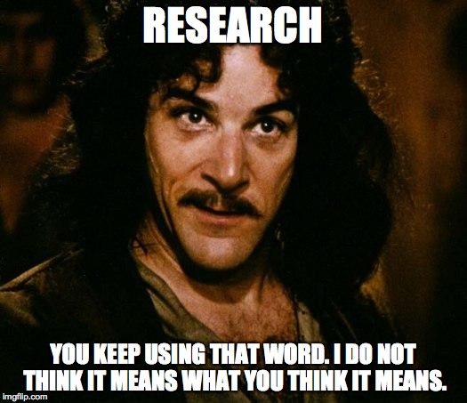

Slide 3
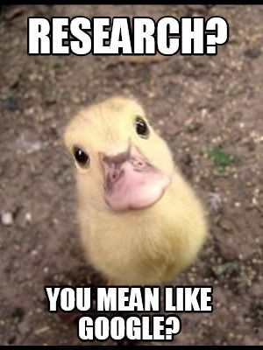

Slide 4
No, I don’t mean Google…
Research for a project, paper, or assignment is much more than just Googling something…but it can be just as easy!
Let’s look at some places that will give us the quality information we need, but don’t require a ton of work!

Slide 5
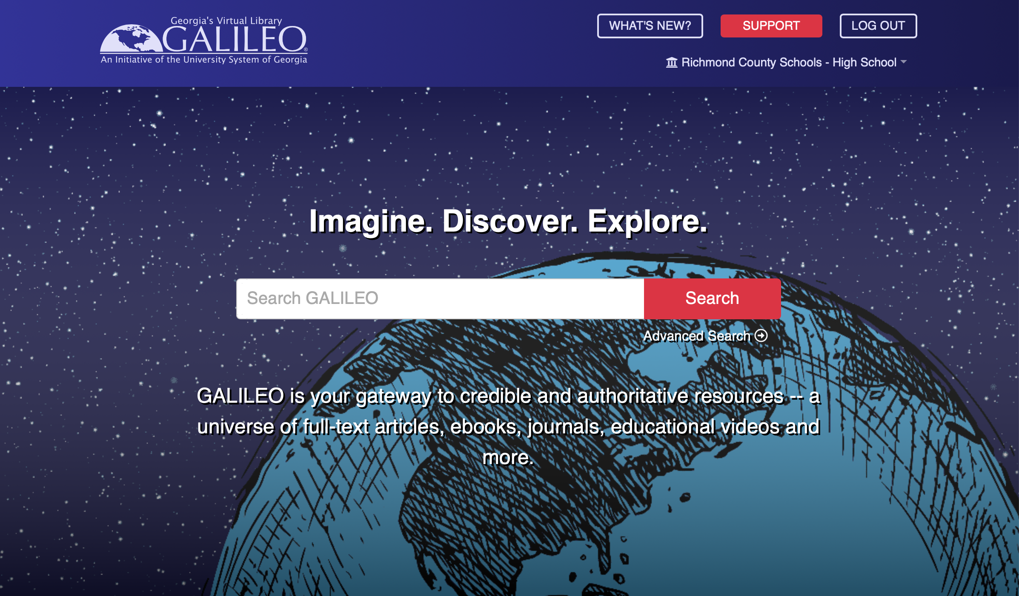
Galileo (This is the #1 site to use for research)
Click on the picture to go to the Galileo site!

Slide 6
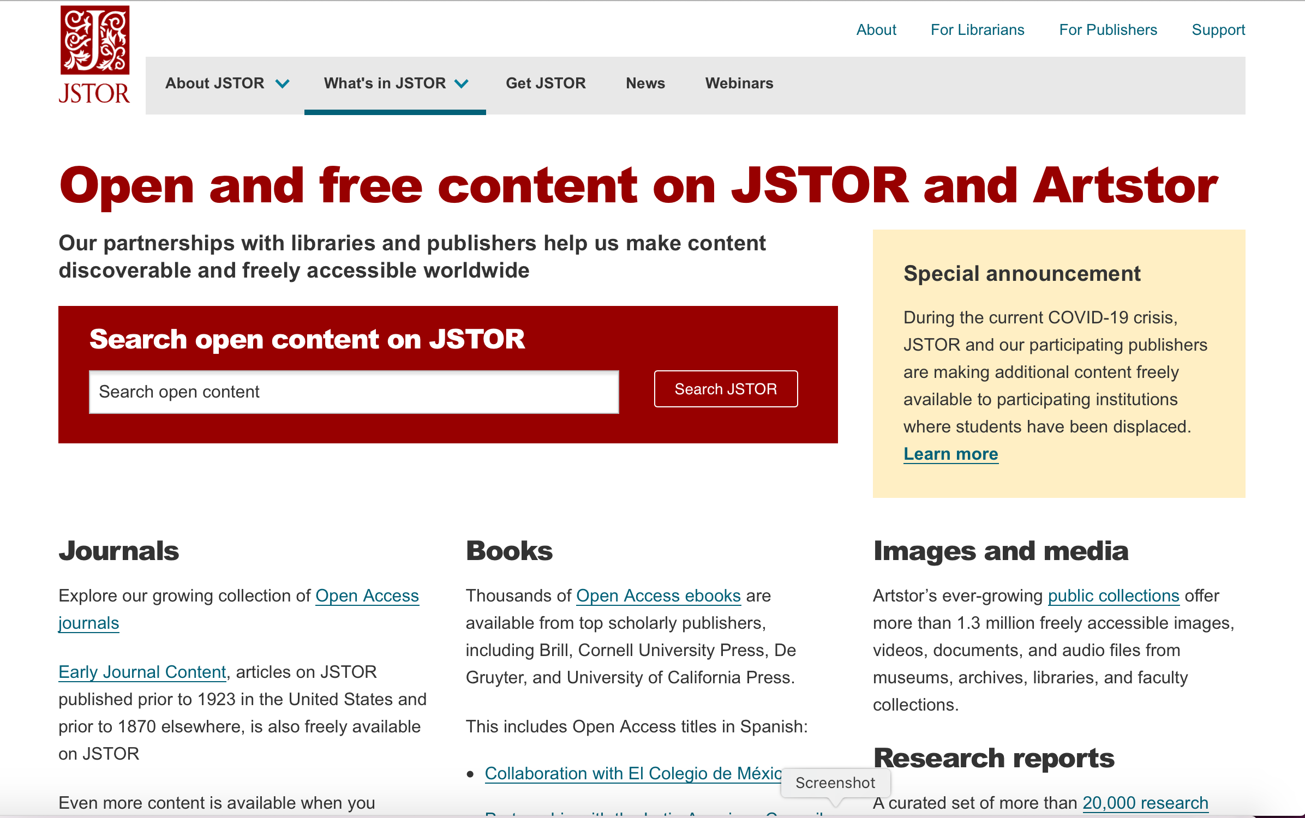
JSTOR/Artstor (like Galileo but has more multimedia items)

Slide 7
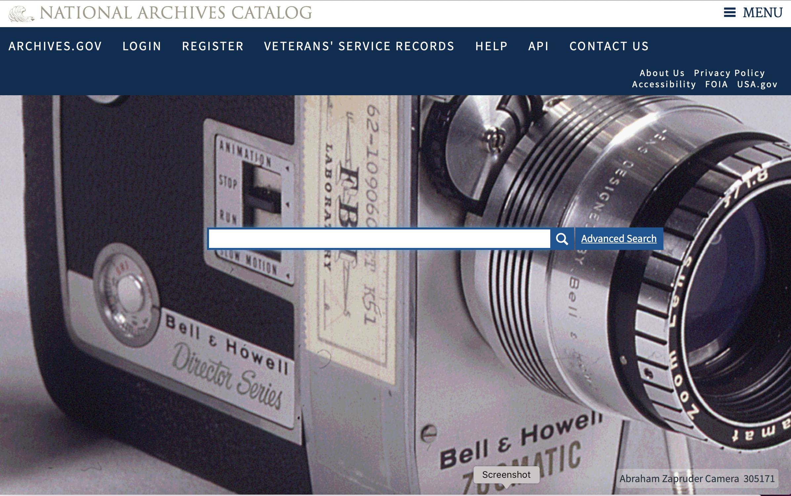
National Archives (good for history research and finding primary sources)

Slide 8
I found something I want to use…now what?

Slide 9
Save it/Email it
Once you find an article, book, or reference you want to use, you need to save it or email it to yourself.
Depending on which site you used this can be really simple
Check out the next few slides for how to save/email information from the different site options

Slide 10
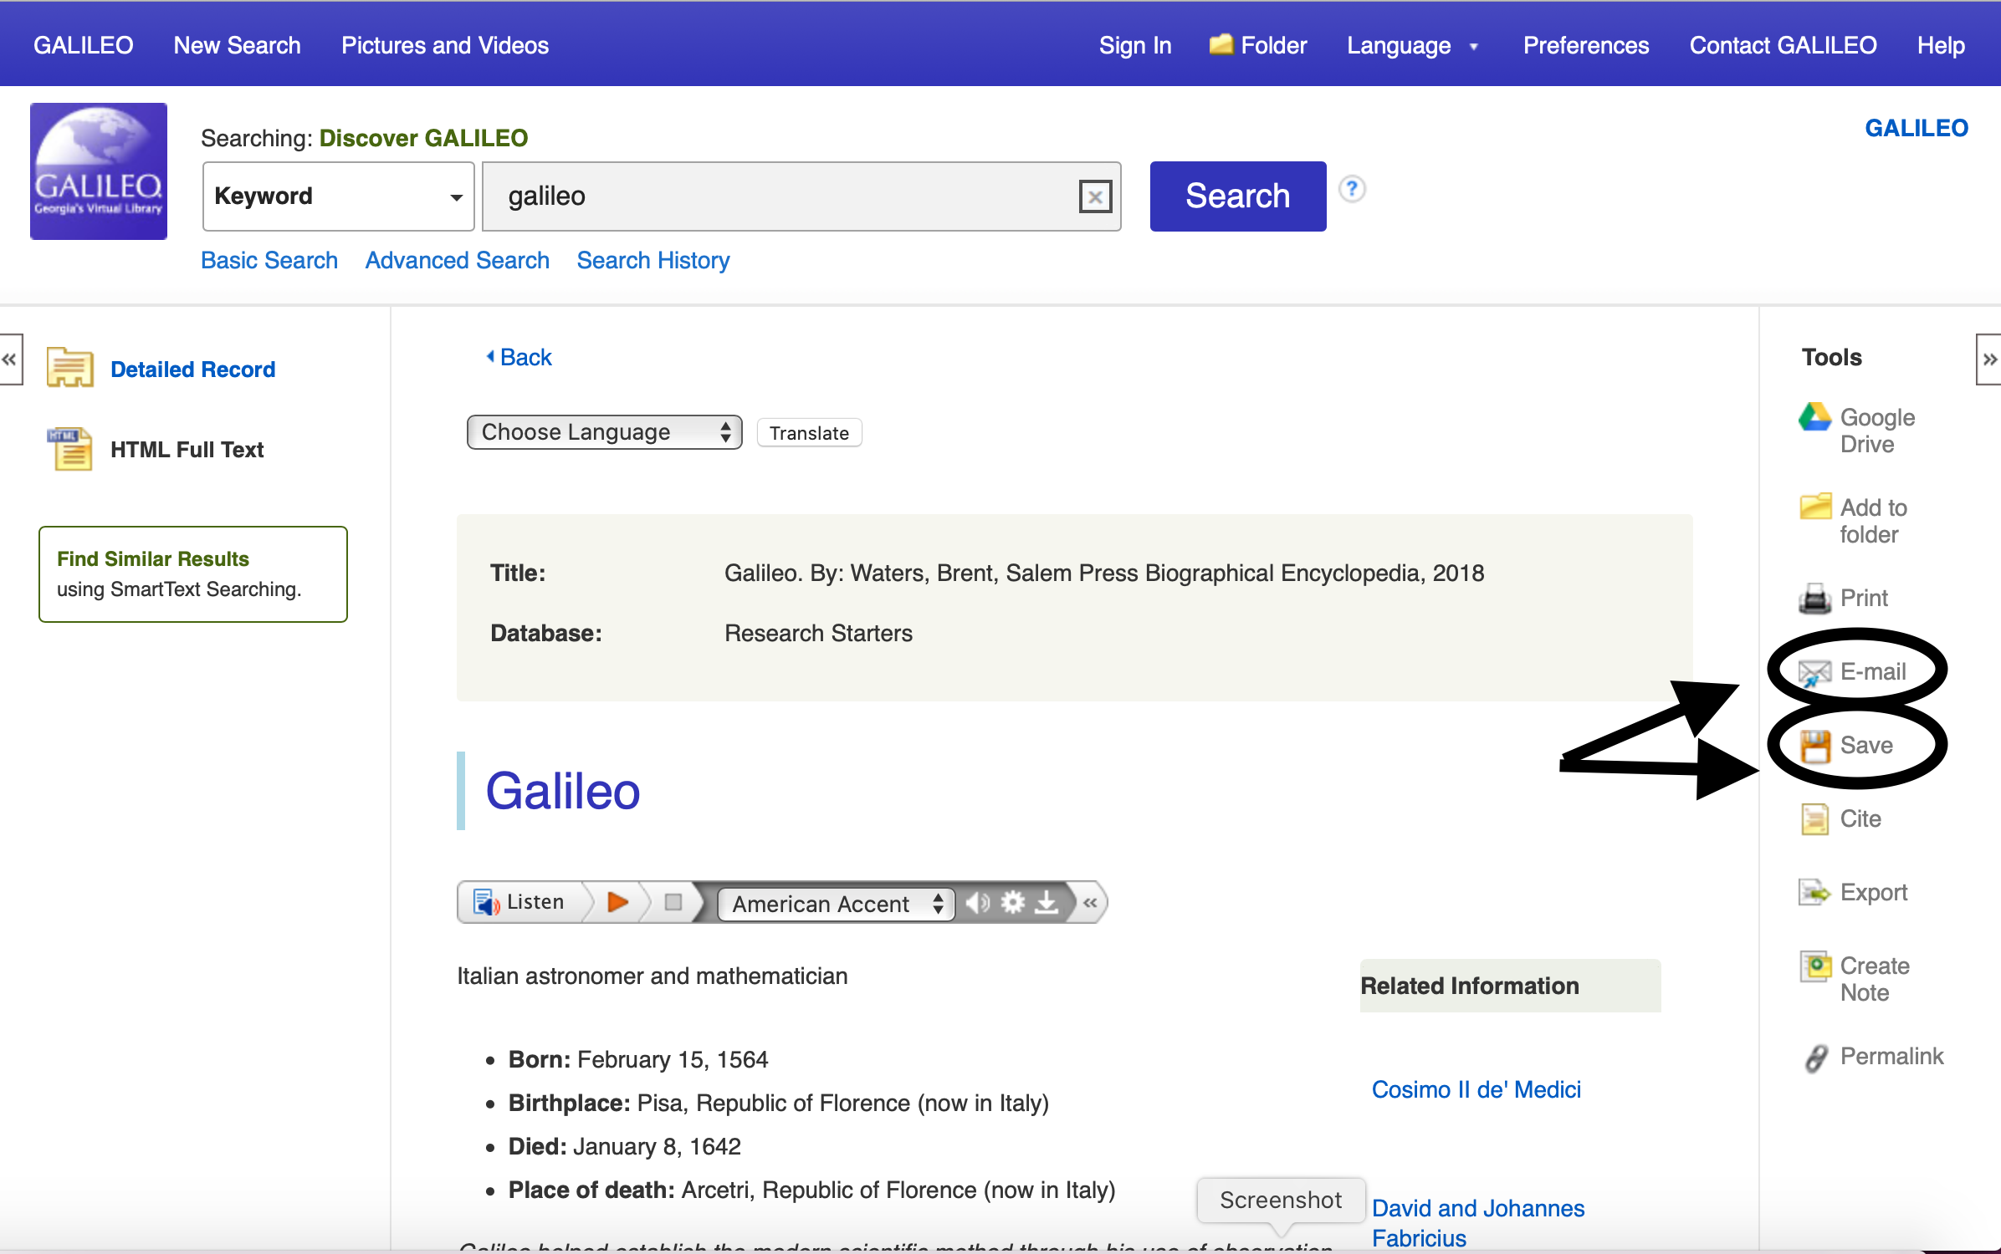
Galileo
Once you find an article in Galileo, click on it. You will see some options on the right. Email will send it to you, but you must use your personal email. Save will save it to the computer.

Slide 11
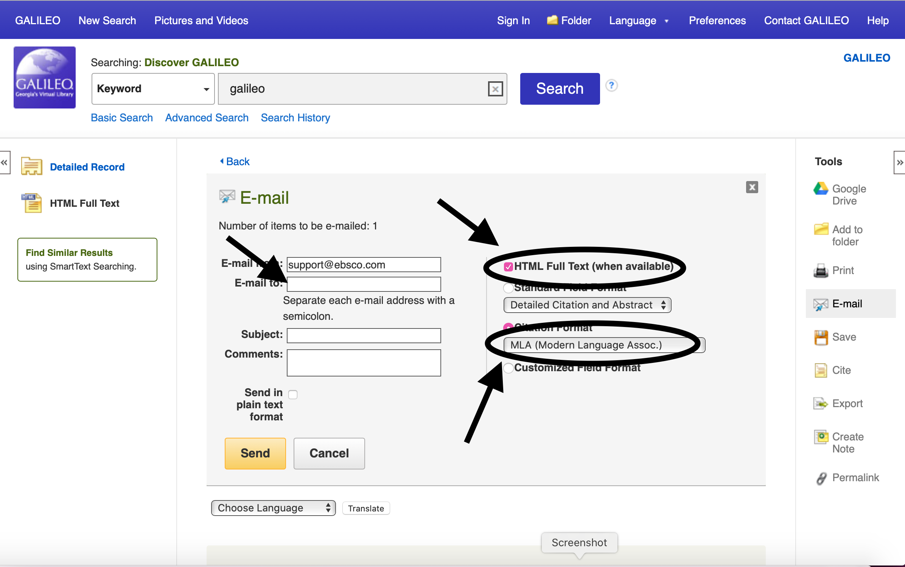
Galileo
-Your email goes where it says “Email to:”
-Make sure all Full Text options have a check in the box
-Make sure Citation format is selected and it says MLA
-Then hit ”Send”

Slide 12
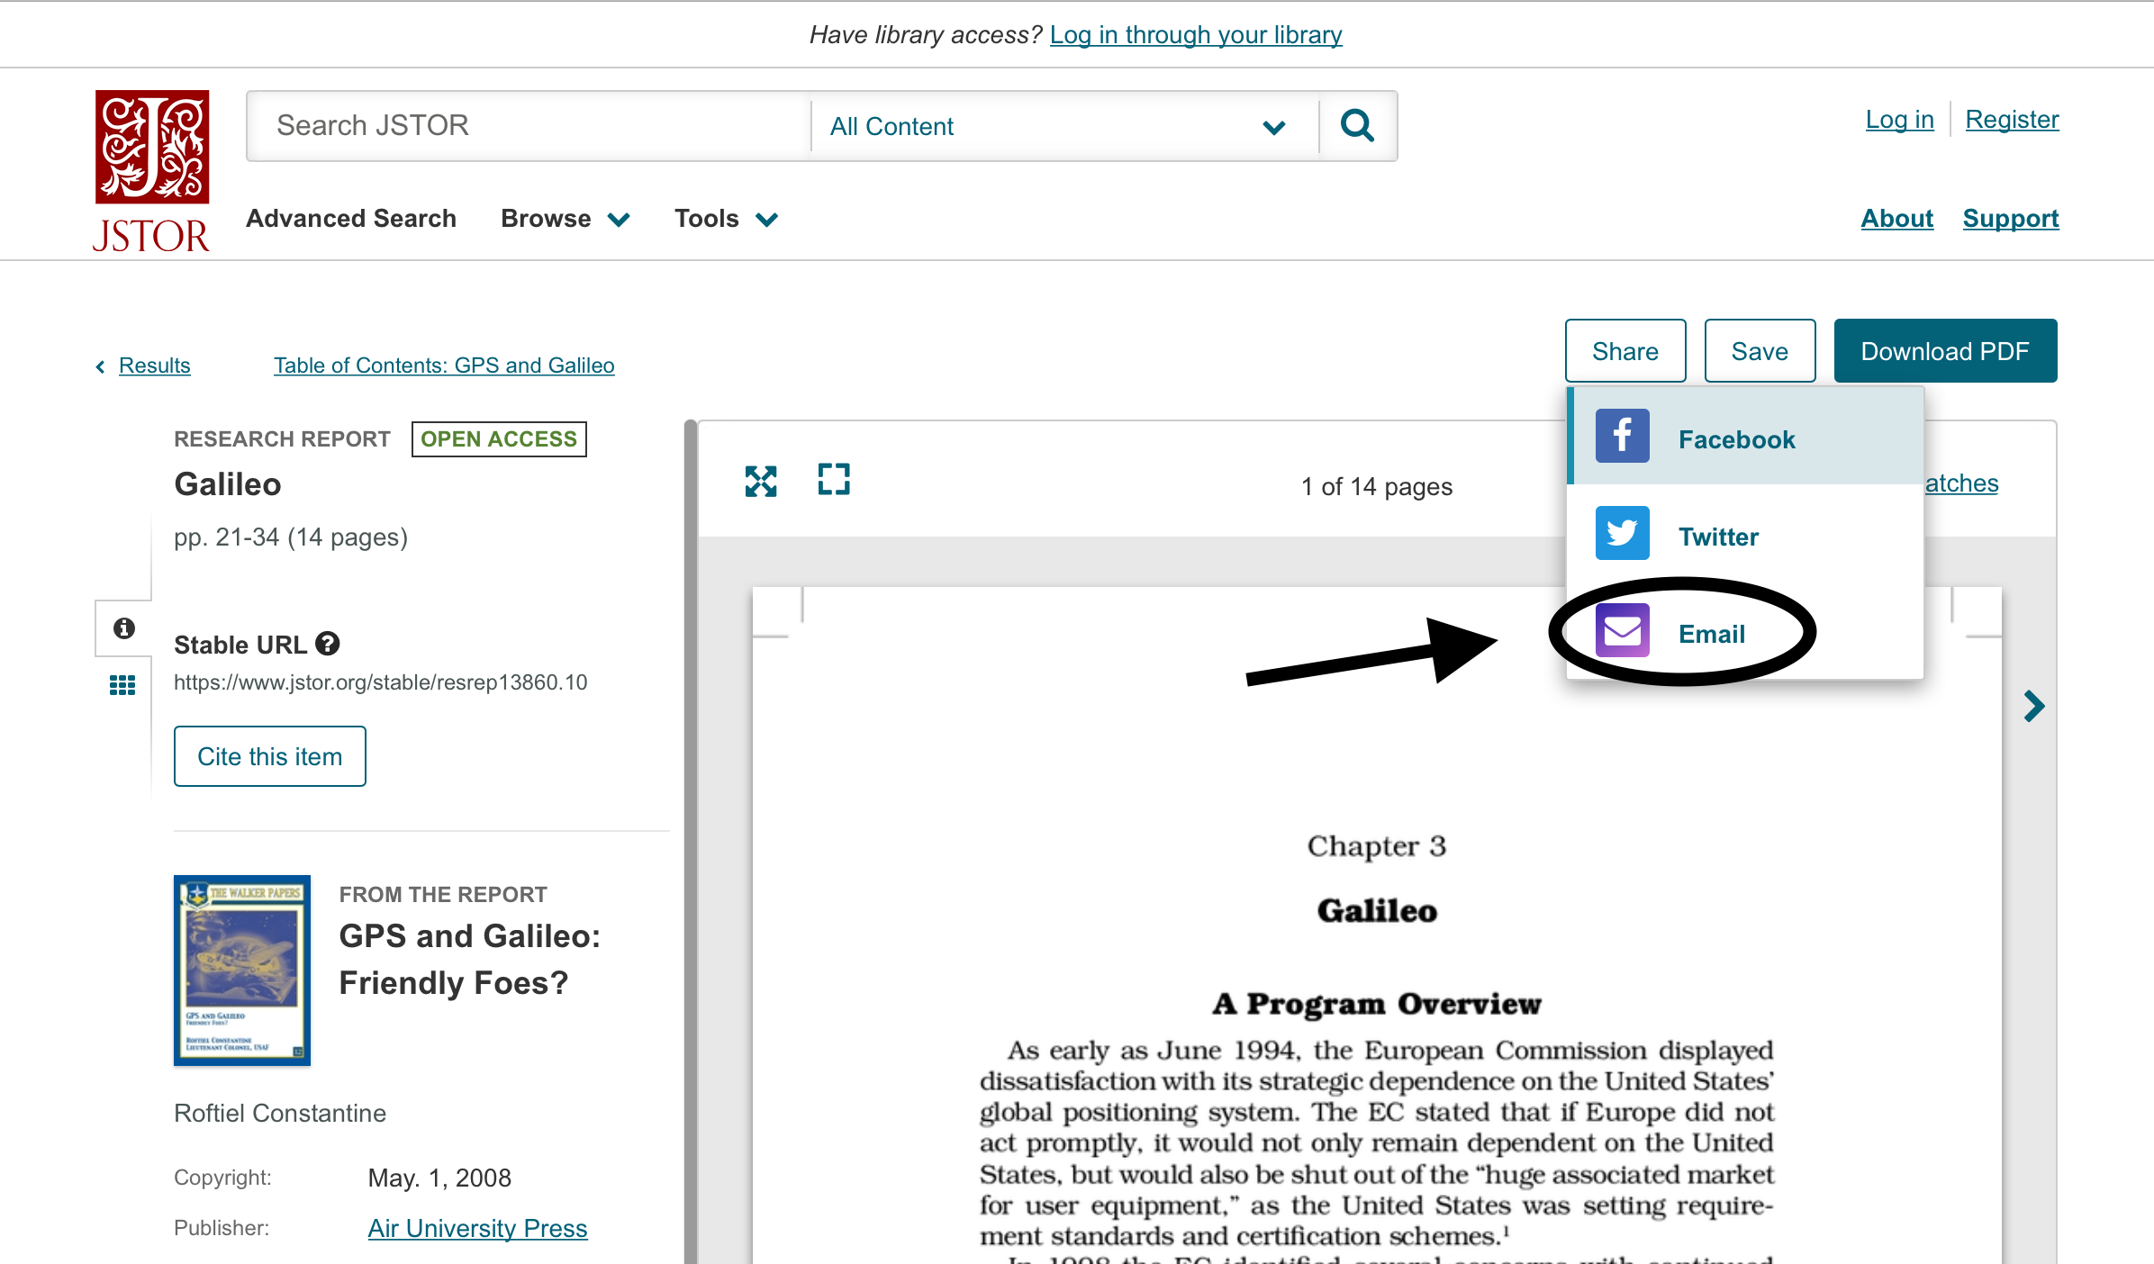
JSTOR/Artstor
-Click on the article you want.
-Click ”Share” and then select email.
-Type your email and send!

Slide 13
CITE IT…CITE IT…CITE IT

Slide 14
Galileo
It does it for you!
Yep, if you follow the instructions for save it/email it, the citation will be included!

Slide 15
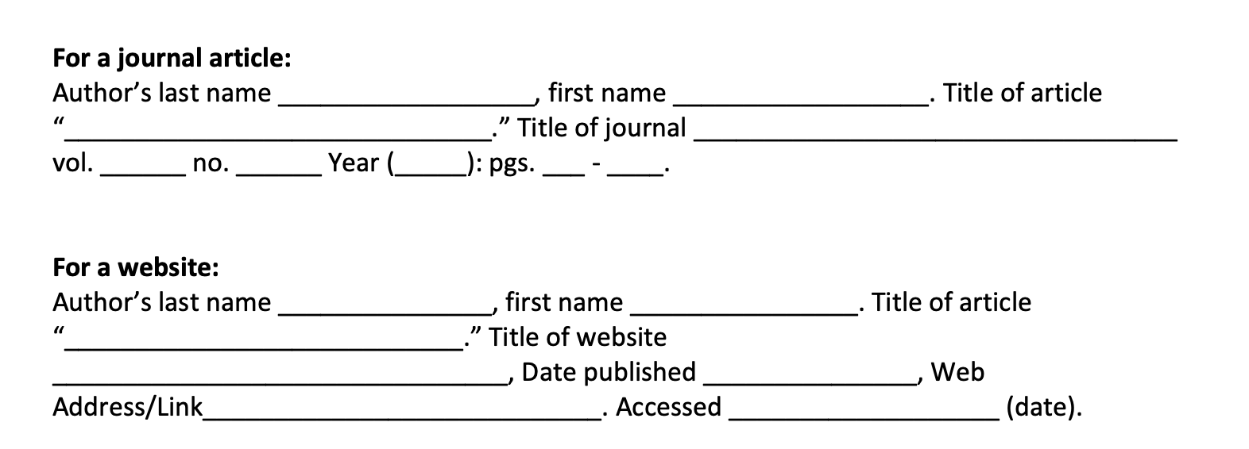
Any other site…you will have to do it the hard way ☹
Here’s some help to get you started…also check out homepage for MLA Format Link

